Slide 1
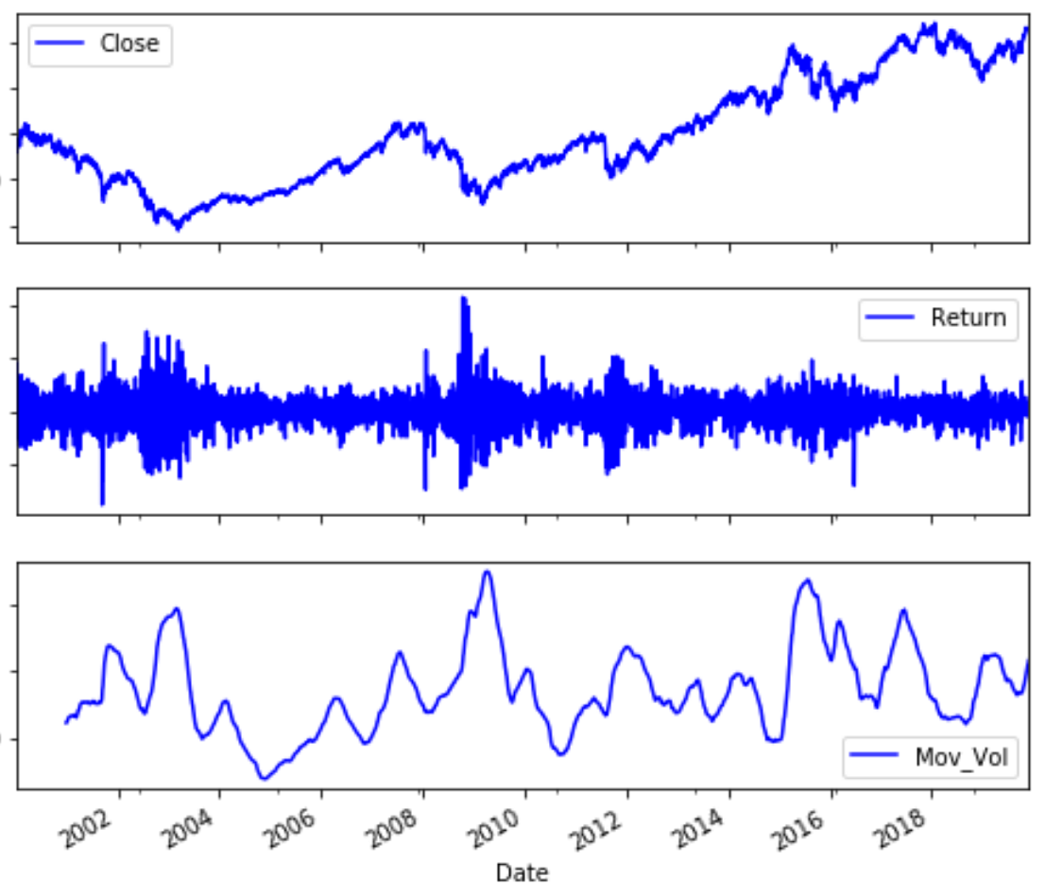
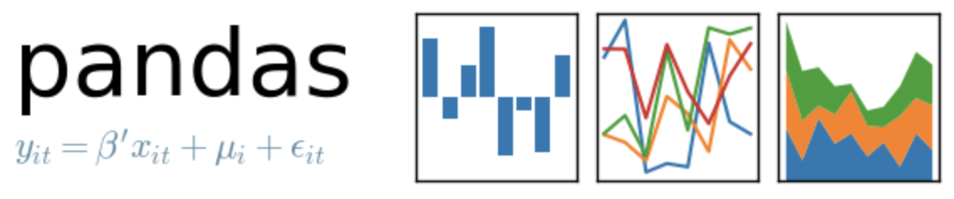
Close, Return, and Return Vol

Slide 2
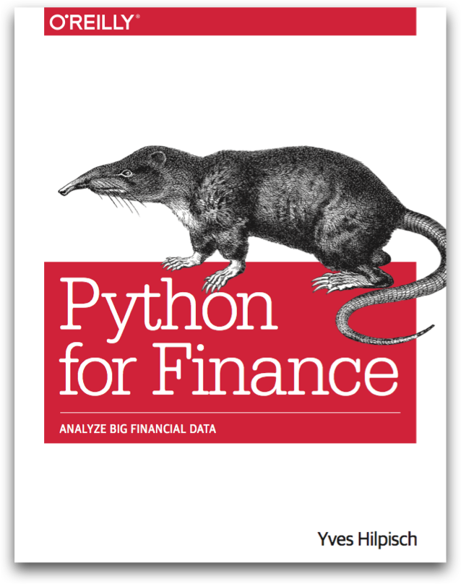
Reference
Chapter 6 of Python for Finance (O'Reilly)
야후파이낸스 데이타 획득하기
Code

Slide 3
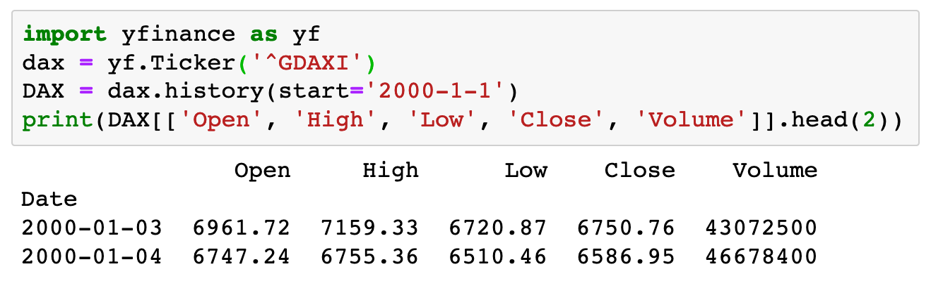

Slide 4
야후파이낸스 데이타 획득하기

Slide 5
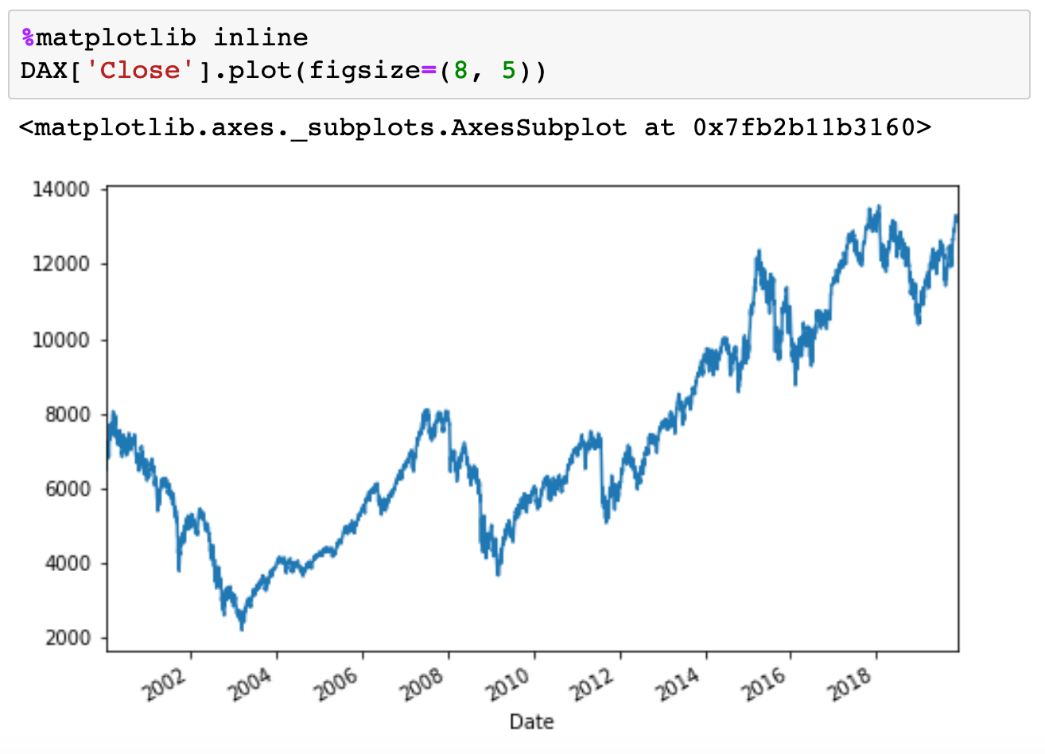

Slide 6
Plot Method

Slide 7
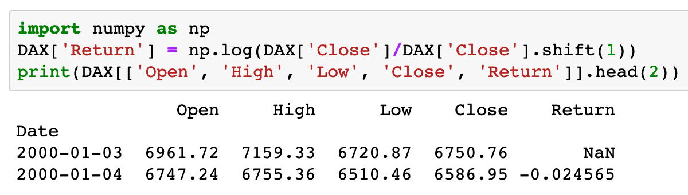

Slide 8
Yesterday’s Data

Slide 9
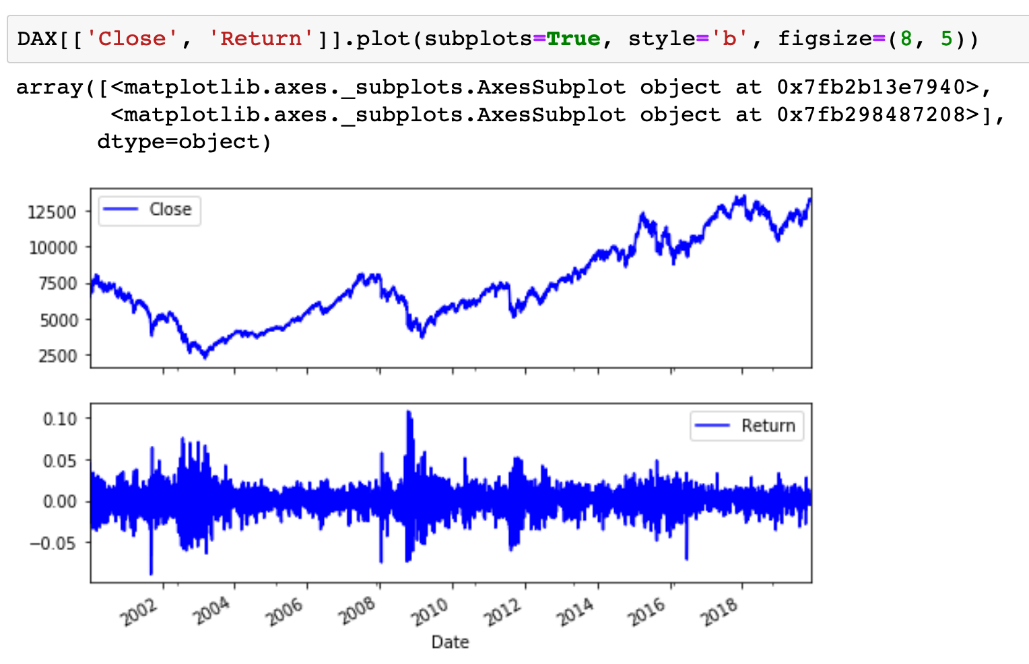

Slide 10
subplots=True

Slide 11
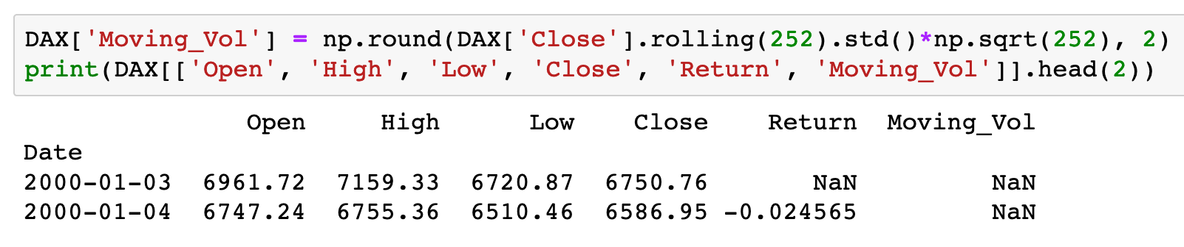

Slide 12
Moving

Slide 13
Moving
Vol

Slide 14
Moving
Vol
Annualize

Slide 15
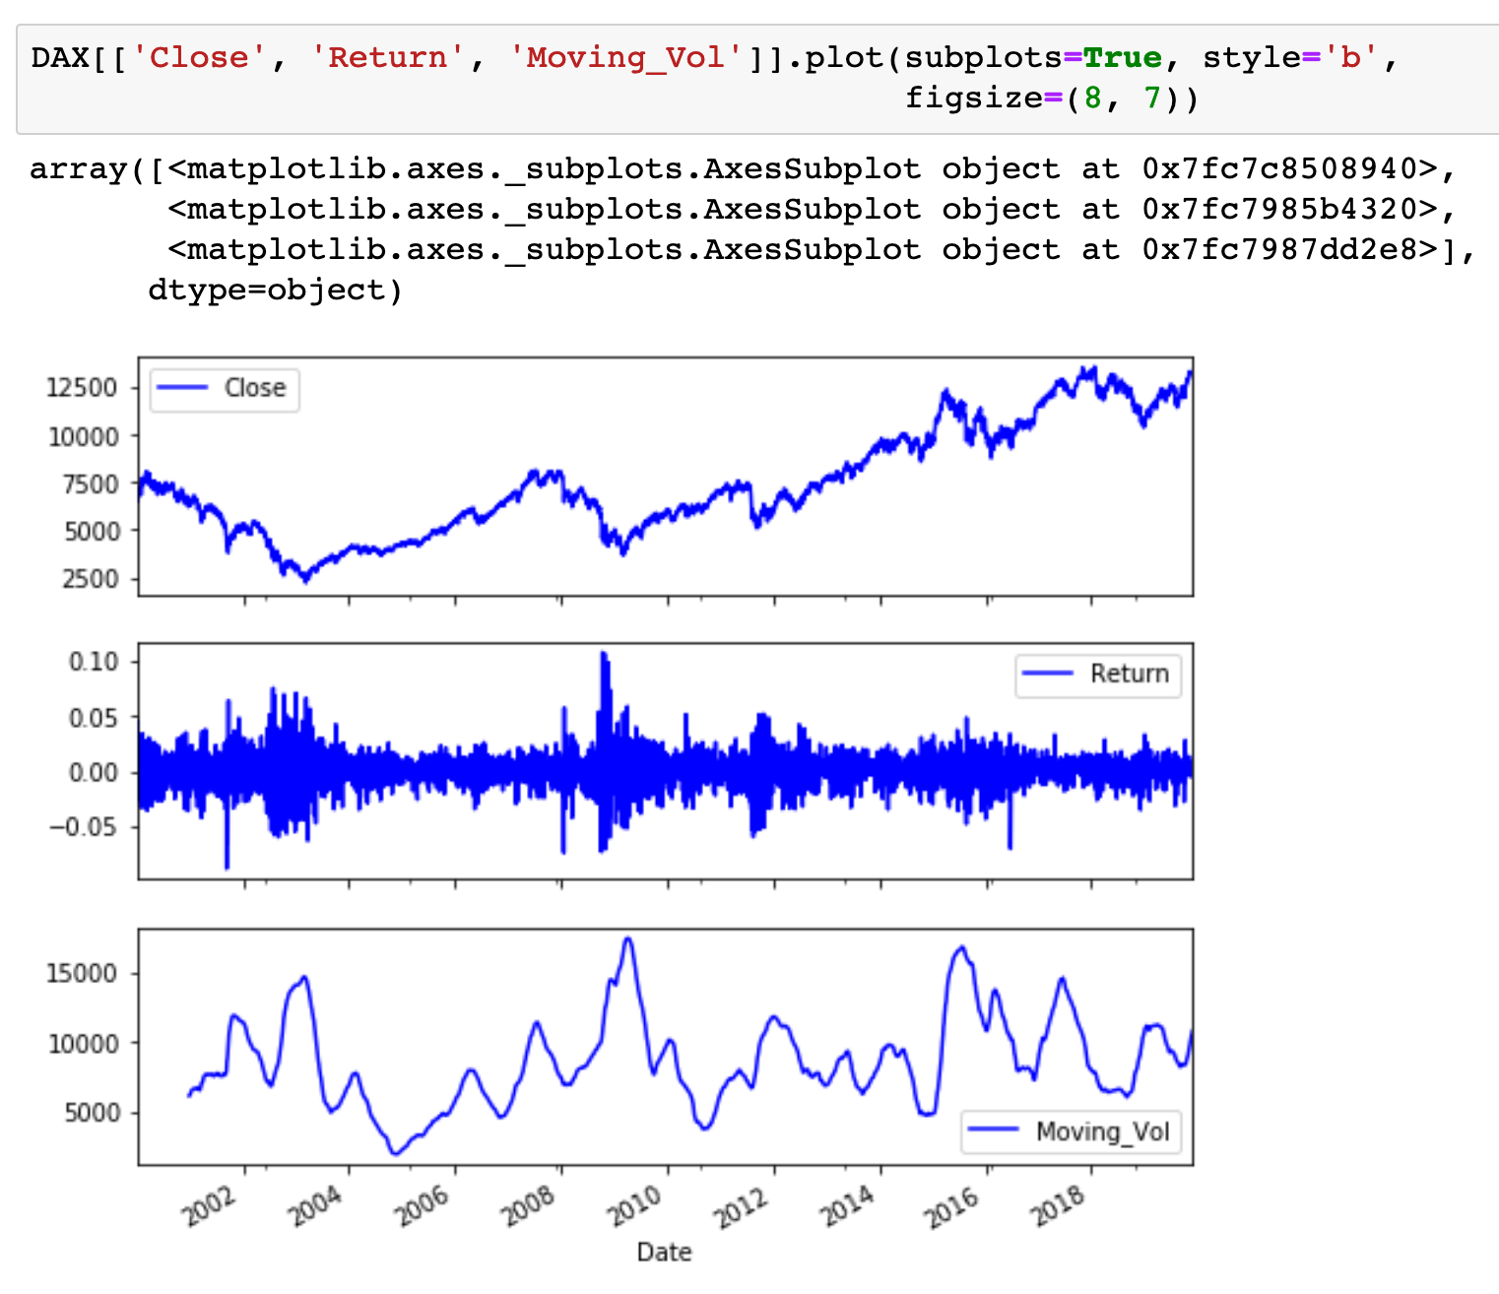

Slide 16
style=‘b’

Slide 17
Bonus!
Moving Average

Slide 18
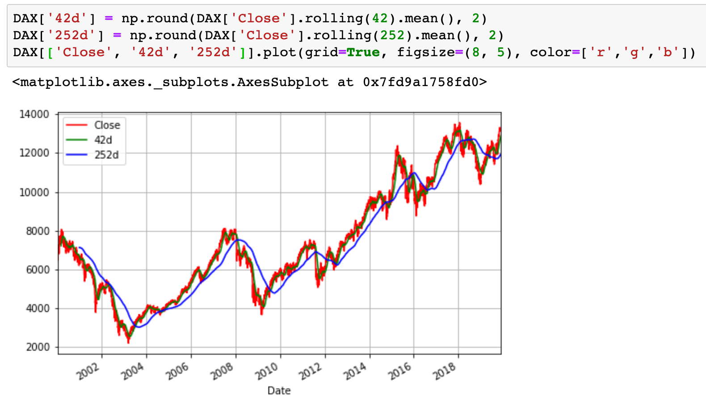

Slide 19
Moving

Slide 20
Moving
Average

Slide 21
Moving
Average
color

Slide 22
Now
Let’s Play with Code

